Slide 1
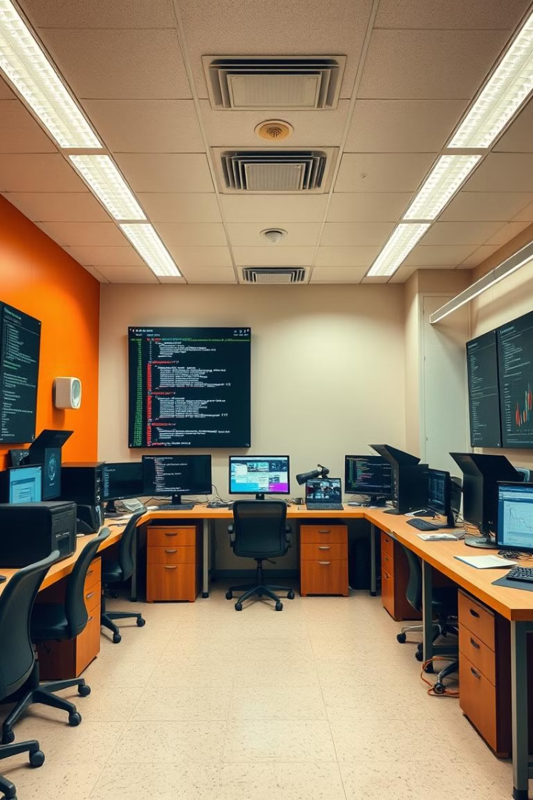
LLM-News Research Tool Using Groq & LangChain Framework
An innovative project designed to streamline news research by summarizing news articles using advanced language models and the LangChain framework.
Developed by Priyanka Verma, Data Science Intern, this tool aims to provide concise and relevant news summaries, enhancing the efficiency of quick research processes.

Slide 2
Project Overview & Purpose
Project Overview
Purpose
This News Research Tool leverages LLMs to automatically summarize news articles, providing researchers with quick access to key information.
The primary goal is to enhance the efficiency of news research by delivering concise summaries of relevant news, saving time and improving decision-making.

Slide 3





Tech Stack & Tools
Python
LangChain
NewsAPI
The core programming language for the project, providing a versatile and powerful platform for development.
A framework for developing applications powered by language models, enabling seamless integration and efficient summarization.
A comprehensive news data source, providing access to a wide range of articles for summarization.
Groq Cloud API
A cloud-based API for accessing powerful language models, facilitating high-quality summarization.

Slide 4

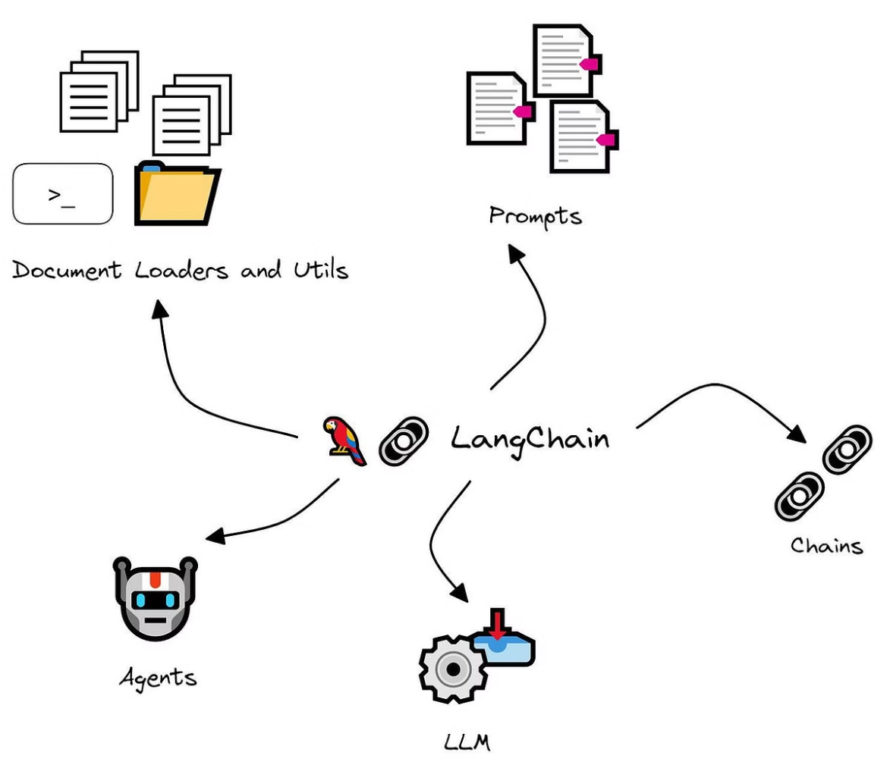




Project Workflow
Data Fetching
Retrieving news articles from various sources using the NewsAPI.
Summarization
Using LangChain and Groq Cloud API to generate concise summaries of the fetched articles.
User Query
Allowing users to input specific queries to filter and refine the news summaries.
Response
Delivering the summarized information to the user in a clear and efficient manner.

Slide 5
Environment Setup
Installing Dependencies
Setting Up APIs
Setting up the development environment involves installing necessary Python packages and libraries.
Configuring and integrating the NewsAPI and Groq Cloud API to access news data and language model capabilities.

Slide 6
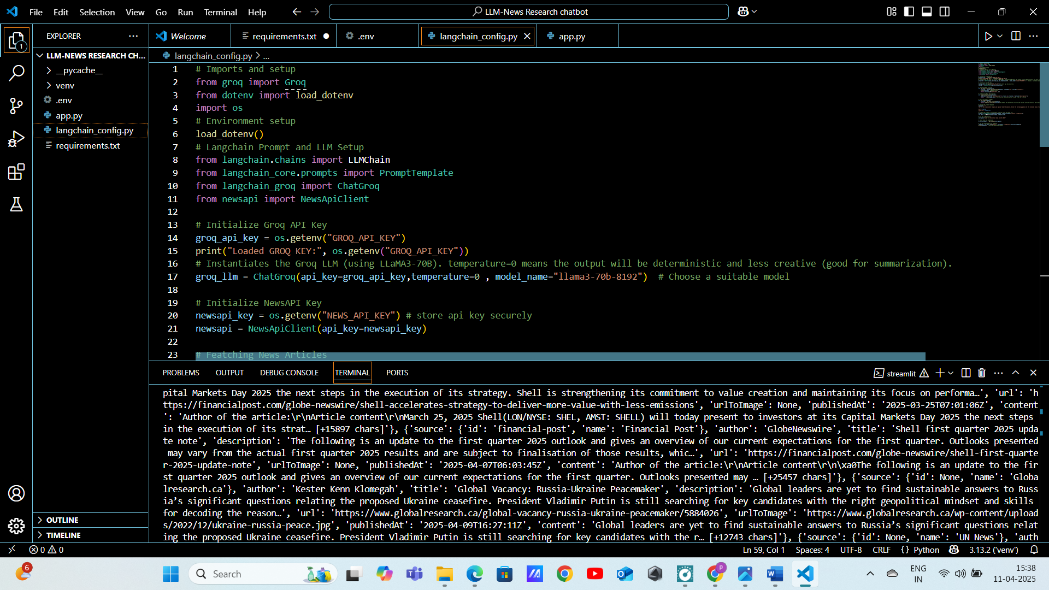
LangChain Configuration
LLM Initialization
Initializing the Language Model (LLM) within the LangChain framework to enable text summarization.
API Integrations
Integrating external APIs, such as Groq, to enhance the summarization process with advanced language processing capabilities.

Slide 7
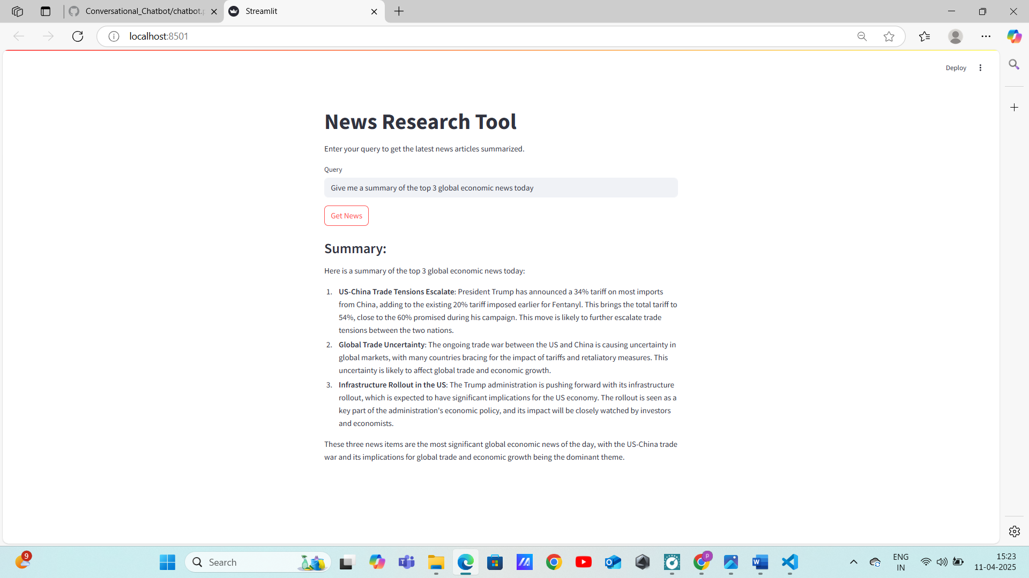
Streamlit Interface
User Input
Query Processing
Summary Output
The Streamlit interface allows users to input queries to filter and refine the news summaries.
The system processes user queries to fetch and summarize relevant news articles.
The summarized information is presented to the user in a clear and efficient manner.

Slide 8
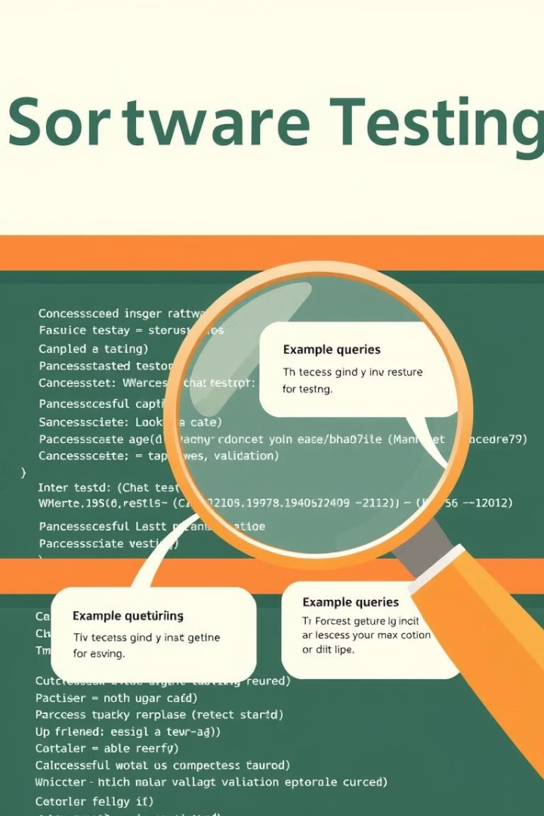
Testing & Validation
Summarization Quality
Ensuring the quality and accuracy of the generated summaries through rigorous testing.
Sample Queries
Using sample queries to validate the system's ability to provide relevant and concise responses.

Slide 9
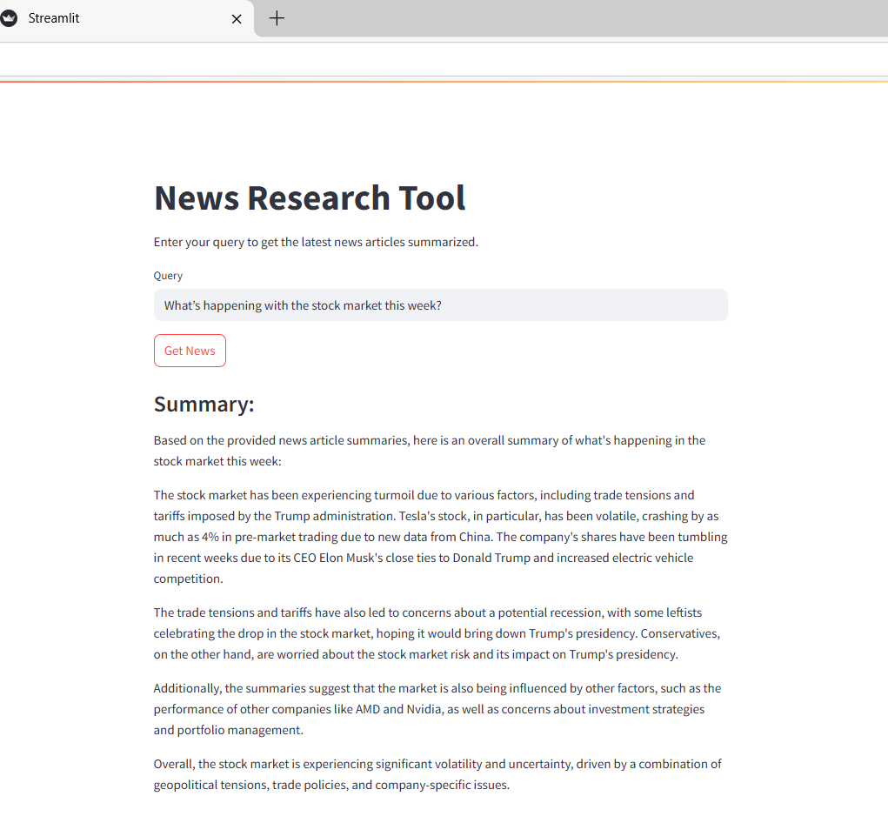
Deployment Readiness
Dependencies
Ensuring all dependencies are properly managed and documented in requirements.txt.
Code Structure
Cleaning and structuring the code for easy deployment and maintenance.
Project structure
LLM-News-Research-Tool/
│
├── app.py
├── langchain_config.py
├── .env
├── .gitignore
├── README.md
└── requirements.txt

Slide 10


